Slide 1
Socket Programming

Slide 2
What is socket??
A Socket is one endpoint of a two-way communication link between two processes running on the network
A socket is bound to a port number so that the TCP layer can identify the application
Process to Process delivery of data needs two identifiers, IP Address and Port Number at each endpoint
Socket Address → combination of IP address and a Port number
I P Address →
200.23.56.8
69
<-- Port Number
Socket Address →
200.23.56.8 69

Slide 3
Client-Server Model
Asymmetric Communication
Client sends requests
Server sends replies
Server/Daemon
Well-known name (e.g., IP address + port)
Waits for contact
Processes requests, sends replies
Client
Initiates contact
Waits for response
Client
Client
Server
Client
Client

Slide 4


Server-Client Communication
Normally, a server has a socket that is bound to a specific port number.
On the client-side: The client knows the hostname of the machine on which the server is running and the port number on which the server is listening.
To make a connection request, the client tries to connect with the server on the server's machine and port.
If everything goes well, the server accepts the connection.
On the client side, if the connection is accepted, a socket is successfully created and the client can use the socket to communicate with the server.

Slide 5
Client-Server Interaction
TCP Server
TCP Client
socket()
bind()
socket()
listen()
connection establishment
accept()
connect()
Data(request)
read()
write()
Data(reply)
write()
read()
End-of-file-notification
read()
close()
close()

Slide 6
The socket function
#include <sys/types.h>
#include <sys/socket.h>
int socket (int family, int type, int protocol); \\This call returns a socket descriptor
family − It specifies the protocol family. like, AF_INET for IPv4 protocols, AF_INET6 for IPv6 protocols
type − It specifies the kind of socket you want. Like, SOCK_STREAM for stream socket, SOCK_DGRAM for datagram socket
protocol − The argument should be set to the specific protocol. Like, IPPROTO_TCP for TCP transport protocol, ‘0’ for system default
Example:
int sockfd= socket(AF_INET,SOCK_STREAM,IPPROTO_TCP); //this will create a TCP socket

Slide 7
The bind function
#include <sys/types.h>
#include <sys/socket.h>
int bind(int sockfd, struct sockaddr *my_addr, int addrlen); \\This call assigns c a local protocol address to a socket.
sockfd − It is a socket descriptor returned by the socket function.
my_addr − It is a pointer to struct sockaddr_in structure cast as a sockaddr * pointer that contains the local IP address and port.
addrlen − Set it to sizeof(struct sockaddr).
Example:
bind(sockfd,(struct sockaddr *)&my ,sizeof(my));

Slide 8
The listen function
listen() --- wait for a connection
The servers process call listen() to tell the kernel to initialize a wait queue of connections for this socket
#include <sys/types.h>
#include <sys/socket.h>
int listen (int sockfd, int backlog);
backlog– maximum length of the pendig connection
Example:
listen(sockfd,10); // this allows maximum 0f 10 connections on pending state

Slide 9
The accept function
The servers process call accept() to accept a new connection from a client trying to connect to the server
#include <sys/types.h>
#include <sys/socket.h>
int accept (int sockfd, (struct sockaddr *)&client, int client_len);
client– its hold the information of new connected client
Example:
accept(sockfd, (struct sockaddr *)&client, &cli_len);

Slide 10
The connect function
The client process call connect() to connect with a server
#include <sys/types.h>
#include <sys/socket.h>
int connect (int socket, (struct sockaddr *)&server_addr,int ser_len);
Example:
connect(sockfd, (struct sockaddr *)&server_addr, serv_len);

Slide 11
The write function
The write function attempts to write bytes to the file associated with the buffer
#include <unistd.h>
int write(int sockfd, const void *buf, int nbyte);
sockfd − It is a socket descriptor returned by the socket function.
buf − It is a pointer to the data you want to send.
nbyte − It is the number of bytes to be written.
Example:
fgets (buffer,255,stdin);
write(sockfd, buffer, strlen(buffer));

Slide 12
The read function
The read function attempts to read bytes from the file associated with the buffer
#include <unistd.h>
int read(int sockfd, const void *buf, int nbyte);
sockfd − It is a socket descriptor returned by the socket function.
buf − It is the buffer to read the information into.
nbyte − It is the number of bytes to read.
Example:
read (sockfd, buffer , strlen(buffer));

Slide 13
Utility Functions
Byte Ordering:
Host Byte Order to Network Byte Order:
htons(), htonl()
Network Byte Order to Host Byte Order:
ntohs(), ntohl()
IP Address format:
Aschii dotted to Binary: inet_aton()
Binary to Aschii dotted : inet_ntoa()

Slide 14
Address Structures
sockaddr:
This is a generic socket address structure to hold the socket information
Will be passed in most of the socket function calls
sockaddr_in:
This help to reference to the socket element
struct sockaddr_in { short int sin_family;
unsigned short int sin_port;
struct in_addr sin_addr;
unsigned char sin_zero[8]; //not used
};
In_addr:
This structure used to hold 32 bit netid/hostid
struct in_addr { unsigned long s_addr; };

Slide 15
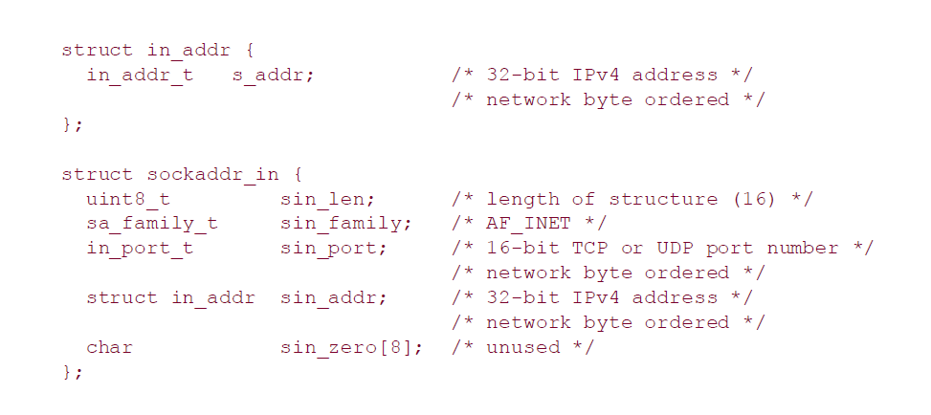
Socket Address Structures
#include<netinet/in.h>

Slide 16
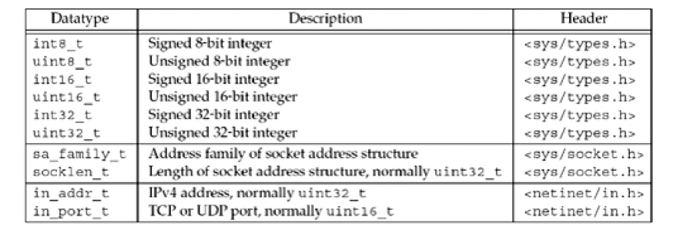
Socket Address Structures
struct sockaddr_in { short int sin_family;
unsigned short int sin_port;
struct in_addr sin_addr;
unsigned char sin_zero[8]; //notused
};

Slide 17
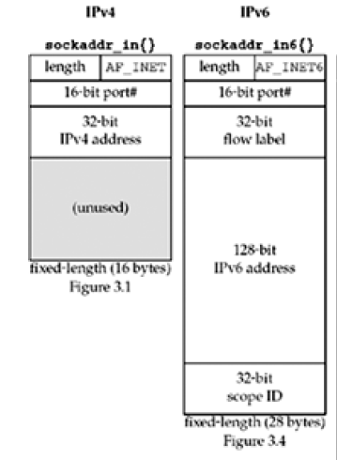
Comparison of Socket Address Structures

Slide 18
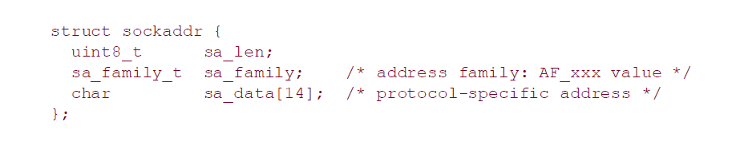
Generic socket address structure
#include<sys/socket.h>
Example:
bind(sockfd, (struct sockaddr *) &serv_addr, sizeof(serv_addr))
Socket functions that accept socket address structure(bind, accept etc) must accept all type of socket address structure(IPv4, IPv6)
The question arise as to which socket address structure type these function should specify
The generic socket address structure(sockaddr) fill the gap

Slide 19
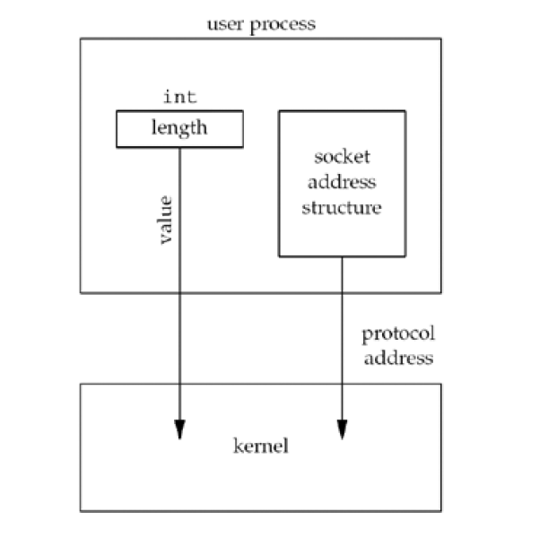
Value-Result Arguments
Example:
length= sizeof(serv_addr);
connect(sockfd, (struct sockaddr*)&serv_addr, length);

Slide 20
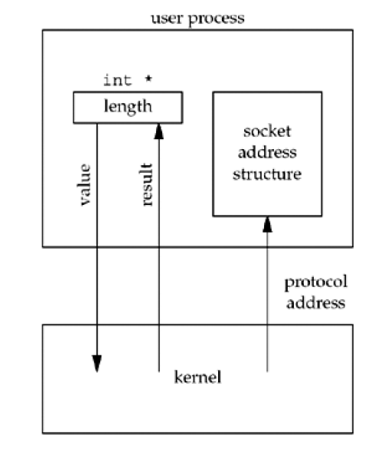
Value-Result Arguments
Example:
length=sizeof(cli_addr);
accept(sockfd, (struct sockaddr *)&cli_addr, &length)

Slide 21
Value-Result Arguments
Server
client
accept(sockfd, (struct sockaddr *)&cli_addr, &clilen)
sleep
connect (sockfd, (struct sockaddr *)&server_addr,ser_len)
cli_addr fill with client ip address and port no(done by kernal)

Slide 22
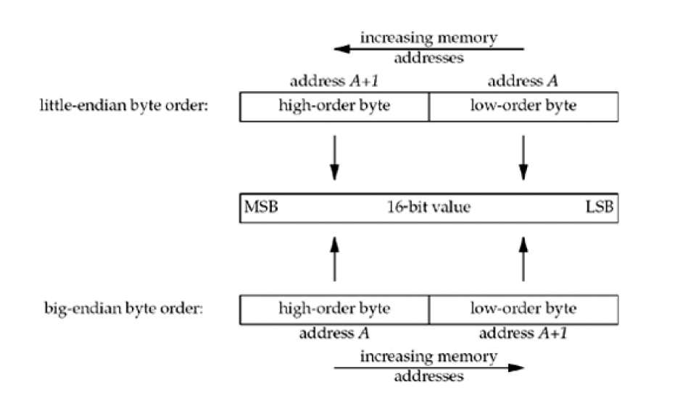
Byte Ordering Functions

Slide 23
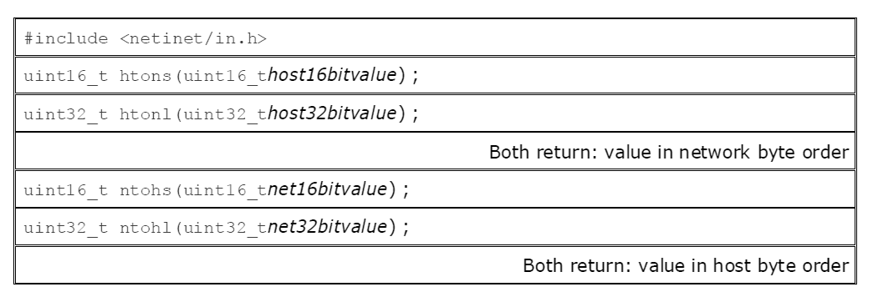
Byte Ordering Functions

Slide 24
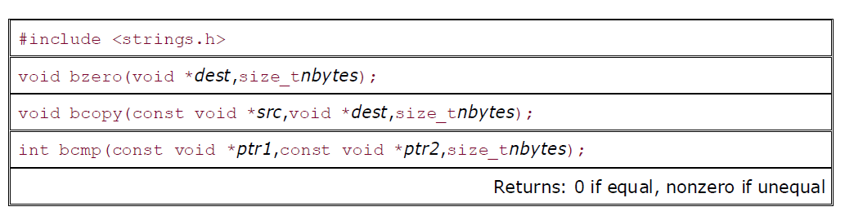
Byte Manipulation Functions

Slide 25
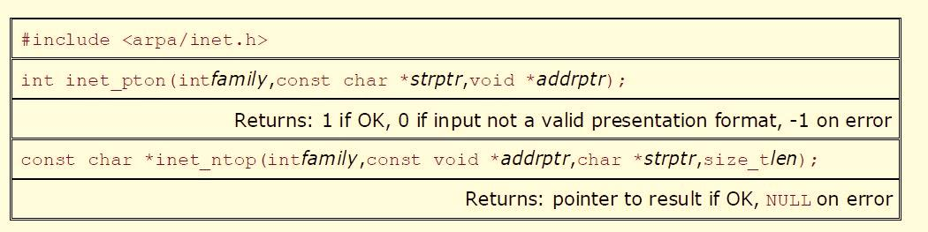
Inet_pton and inet_ntop Functions

Slide 26
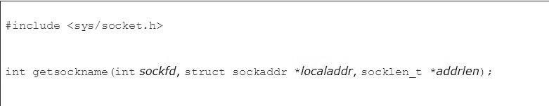
Getsockname()
After connect successfully returns in a TCP client that does not call bind, getsockname returns the local IP address and local port number assigned to the connection by the kernel.
After calling bind with a port number of 0 (telling the kernel to choose the local port number), getsockname returns the local port number that was assigned.

Slide 27
http://utfi.co.in/local/registration/registration.php

Slide 28
Bipolar - AMI and Pseudoternary
Code uses 3 voltage levels: +, 0, -, to represent the symbols (note not transitions to zero as in RZ).
Voltage level for one symbol is at “0” and the other alternates between + & -.
Bipolar Alternate Mark Inversion (AMI) - the “0” symbol is represented by zero voltage and the “1” symbol alternates between +V and -V.
Pseudoternary is the reverse of AMI.

Slide 29
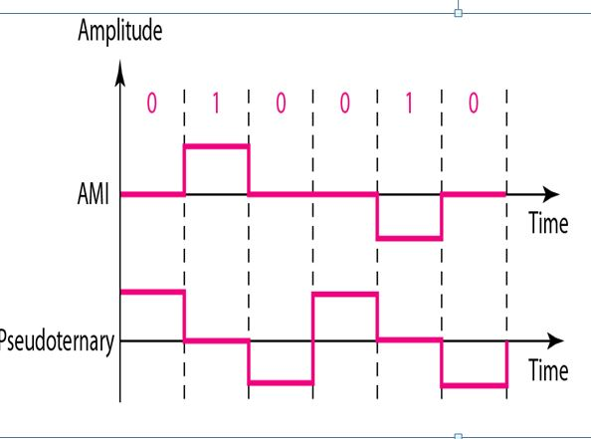
Bipolar - AMI and Pseudoternary

Slide 30
Block Coding
For a code to be capable of error detection, we need to add redundancy, i.e., extra bits to the data bits
Synchronization also requires redundancy - transitions are important in the signal flow and must occur frequently
Block coding is done in three steps: division, substitution and combination

Slide 31
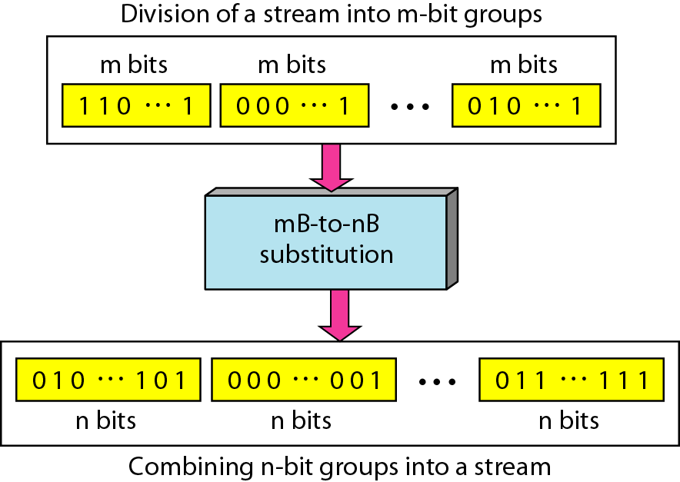
Block Coding

Slide 32
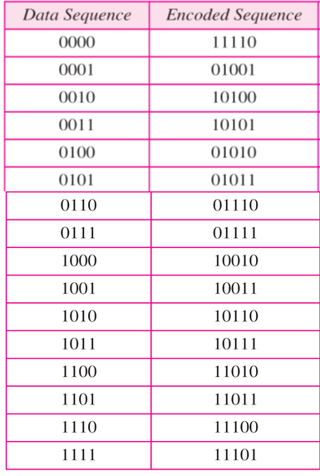
Block Coding

Slide 33
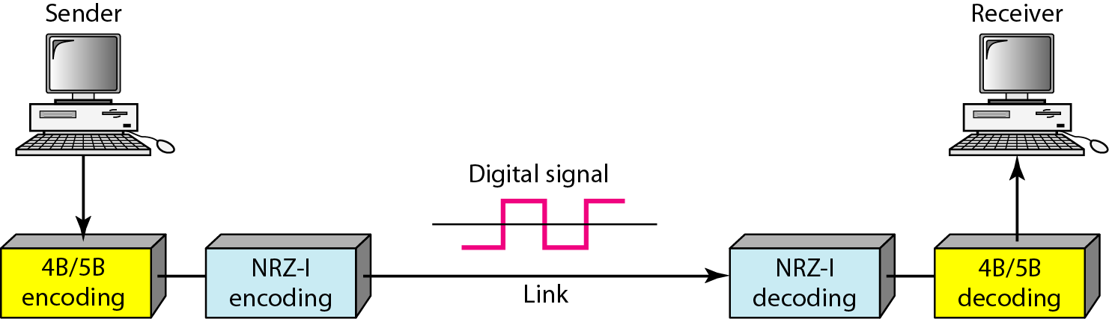
Block Coding

Slide 34
Print connected client IP address and Port No on server side.
Hints: When client call connect function request send to server side.
If server accept the request, within accept function of server-- accept(sockfd, (struct sockaddr *)&cli_addr, &clilen) – cli_addr fill with connected client IP address and Port No.
You have to print proper variables of cli_addr to print the client IP address and Port No.

Slide 35
Write a client-server program where client will send an unsorted array and server will sort the array and reply back the sorted array to client
Example:
Client: Server:
10 | 2 | 3 | 14 | 6 | 1
10 | 2 | 3 | 14 | 6 | 1
Sorting Algorithm
1 | 2 | 3 | 6 | 10 | 14
1 | 2 | 3 | 6 | 10 | 14

Slide 36
Concurrent Server
Concurrent server can handle multiple client at a time
Client_1
Server
Client_2
:
:
Client_n

Slide 37
Concurrent Server
We can implement Concurrent server using fork() system call
If fork() returns a negative value, the creation of a child process was unsuccessful
fork() returns a zero to the newly created child process
fork() returns a positive value, the process ID of the child process, to the parent
Parent
fork()
Parent
Pid=child_id
Child
Pid=0

Slide 38
Iterative Server
Client
Server
Connection Request
Connect()
listenfd
Connection established
Connect()
listenfd
acceptfd

Slide 39
Concurrent Server
Client
Server
Connection Request
Connect()
listenfd
Server parent
Connection established
Connect()
listenfd
acceptfd
fork()
listenfd
Server child
acceptfd

Slide 40
Concurrent Server
Server parent
Client
Connect()
listenfd
Server child
acceptfd

Slide 41
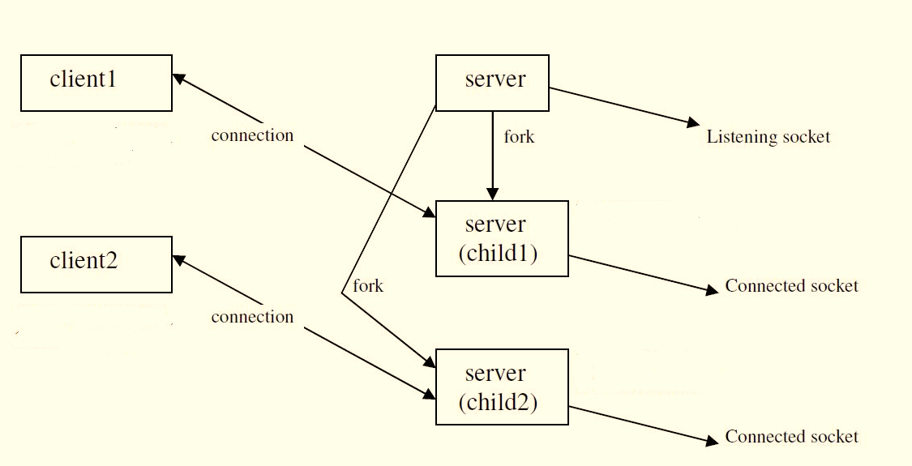
Concurrent Server

Slide 42
Concurrent Server Implementation
To allow the server to handle multiple simultaneous connections, we make the following changes in our code:
After a connection is established, call fork() to create a new process
The child process will close sockfd and will communicate with connected client using read(), write() functions
The parent process closes newsockfd. As all of this code is in an infinite loop, it will return to the listenfd to wait for the next connection.

Slide 43
TCP Connection Establishment
Server
Client
Socket()
bind()
listen()
Socket()
accept()
block
connect()
Sleep
SYN J
SYN K, ACK J+1
ACK K+1
Three-way handshake
Data Transfer

Slide 44
UDP Socket
UDP is connectionless, unreliable
In UDP, there is no connection establishment or termination phase like TCP
In UDP, Sender is not concern about reliability, it just send data
The client does not establish a connection with the server
The client just sends a datagram to the server using the sendto() function
the server does not accept a connection from a client
the server just calls the recvfrom() function, which waits until data arrives from some client

Slide 45
UDP Socket
UDP Server
UDP Client
Socket()
bind()
Socket()
recvfrom()
Sleep until datagram received from client
Data(request)
sendto()
Process request
sendto()
Data(reply)
recvfrom()
close()

Slide 46
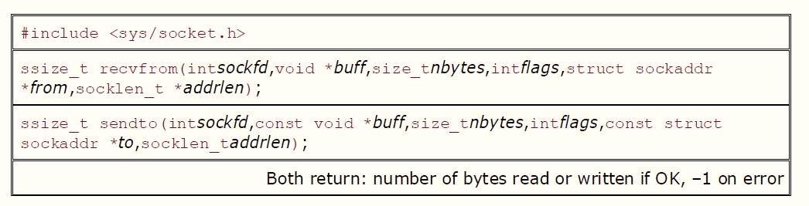
recvfrom() and sendto() Functions

Slide 47
SCTP:Stream Control Transmission Protocol
Stream Control Transmission Protocol (SCTP) is an end-to-end transport protocol that provides services
SCTP Vs. TCP
Head-of-line blocking -- A lost message in one of these streams does not block delivery of messages in any of the other streams. This approach is in contrast to TCP, where a loss at any point in the single stream of bytes blocks delivery of all future data on the connection until the loss is repaired
Multi-homing -- where a host with multiple points of attachment to the Internet, for redundancy purposes, providing an alternate route for the data in case the current interface in use fails for some reason. For call control signaling, such delay is unacceptable when an alternate available path exists. A TCP connection only binds a single point of attachment at either end point.
Message Orientation - In TCP, data sent between two endpoints is a stream of bytes. If needed, an application must provide message framing. In SCTP, message boundaries are preserved. If an application sends a 100-byte message, the peer application will receive all 100 bytes in a single read: no more, no less.

Slide 48
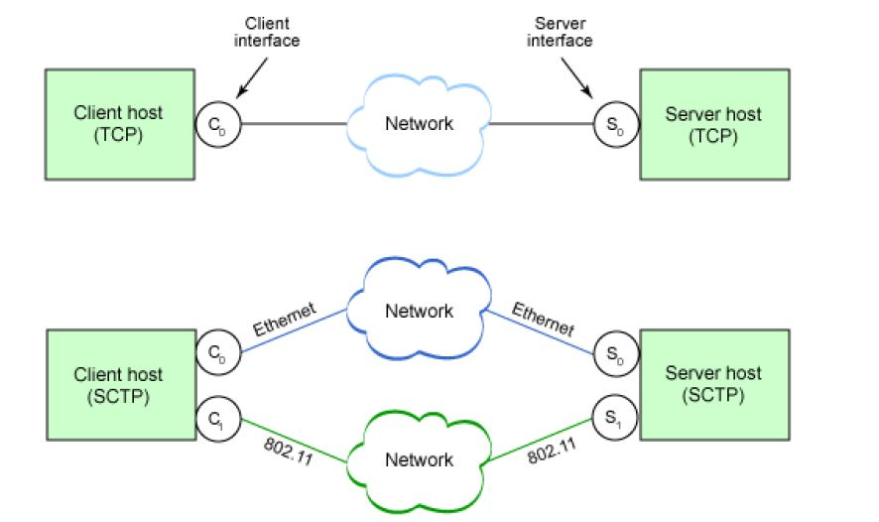
SCTP Vs. TCP : Multi-homing

Slide 49
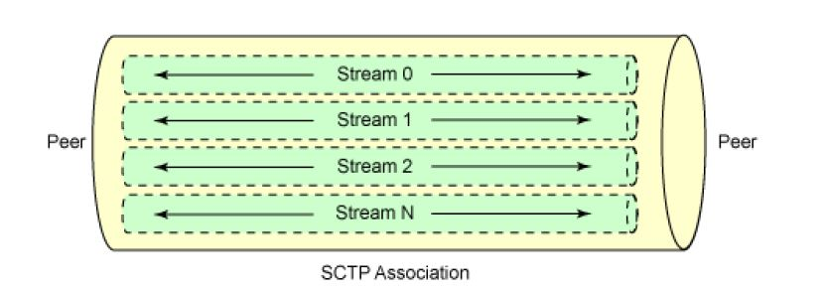
SCTP Vs. TCP : Multi-streaming
Stream 0
TCP Connection

Slide 50
SCTP: one to one: Multi-Streaming
SCTP Server
SCTP Client
socket()
bind()
socket()
listen()
data(request)
connect()
accept()
sctp_sendmsg()
sctp_recvmsg()
data(reply), stream 0
sctp_sendmsg()
sctp_recvmsg()
data(reply), stream 1
sctp_sendmsg()
sctp_recvmsg()
shutdown
Server need not care
close()

Slide 51
SCTP: One to Many Association
SCTP Server
SCTP Client
socket()
bind()
socket()
listen()
data(request)
sctp_sendmsg()
sctp_recvmsg()
data(reply)
sctp_sendmsg()
sctp_recvmsg()
shutdown
close()
Server need not care

Slide 52
SCTP: socket()
sockfd = socket(AF_INET, SOCK_SEQPACKET, IPPROTO_SCTP);
SOCK_SEQPACKET stands for sequenced packet stream.

Slide 53
SCTP: sctp_sendmsg()
sctp_sendmsg(int sockfd, const void *buf, bufsize, struct sockaddr *to, tolen,
unit32_t ppid, unit32_t flags, unit16_t streamno, unit32_t timetolive, unit32_t context )
//returns number of byte written, -1 on error
Example:
sctp_sendmsg (sockfd, (void *) buffer, datalen, (sockaddr*)to, 0, 0, 0, 0, 0, 0);

Slide 54
SCTP: sctp_recvmsg()
sctp_recvmsg(int sockfd, void * msg, size_t len, struct sockaddr * from,
socklen_t * fromlen, struct sctp_sndrcvinfo * sinfo, int * msg_flags);
//returns number of byte read, -1 on read
Example:
sctp_recvmsg( sockfd, (void *)buffer, sizeof(buffer), (struct sockaddr *)from, fromlen,
&sndrcvinfo, &flags );

